Slide 1

Boosting and stacking
DATA ANALYTICS | IRONHACK

Slide 2

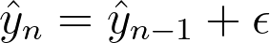
IRONHACK BOOTCAMP
SEQUENTIAL ENSEMBLE METHODS: BOOSTING
In this set of methods each prediction is an improvement over the previous prediction trying to predict the errors of the previous model.

Slide 3
SEQUENTIAL ENSEMBLE METHODS:
Adaptive boosting:
training made upon misclassified observations.
Increase the weight of sample observations in the training data set, where observations are hard to classify.
Gradient boosting :
trains to minimise loss using residual error,
Decision trees based on purity scores are added to the model, against the prior decision tree residual error.

Slide 4
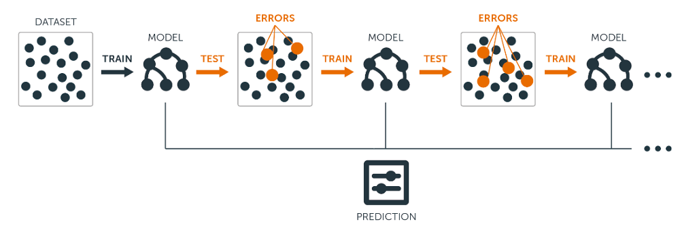
IRONHACK BOOTCAMP
SEQUENTIAL ENSEMBLE METHODS: BOOSTING
Adaboost:
sklearn adaboost regressor
sklearn adaboost classifier
Gradient boosting:
sklearn gradient boosting regressor
sklearn gradient boosting classifier

Slide 5
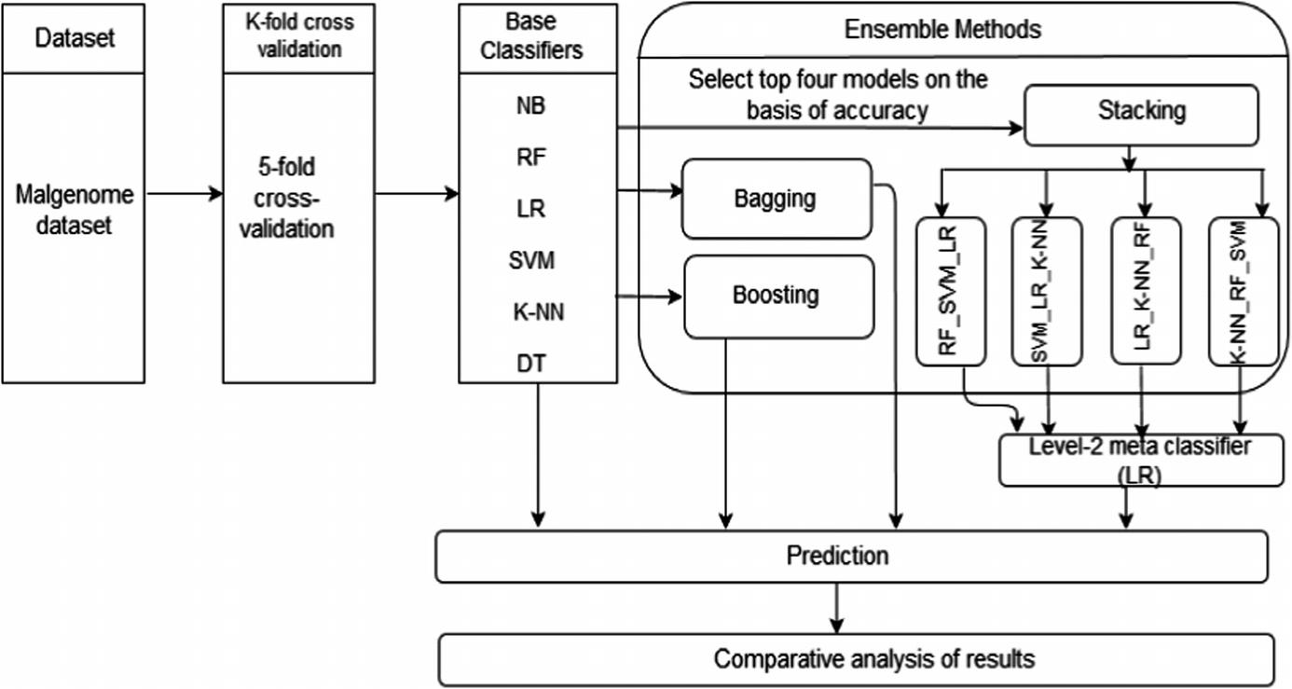
STACKING
Stacked generalisation:
Given multiple models that are skillful in different ways, and the observed errors are uncorrelated, how to choose which to trust?
The new super learner model learns how to best combine 2+ predictions of base machine learning algorithms
The base models chosen are typically different (unlike bagging)
A single simple meta model is then used to combine eg linear regression
Source machine learning mastery

Slide 6


